Slide 1
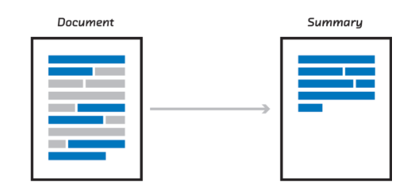
Summarizeit Text Summarizer using M.L & D.L
Under the supervision of Dr. Mustafa Abdul-Salam

Slide 2
Hello!
I am Awad Safwat
I am here because I hope to give a goode presentations about my graduation project :
(Summarizeit : text summarizer App)

Slide 3
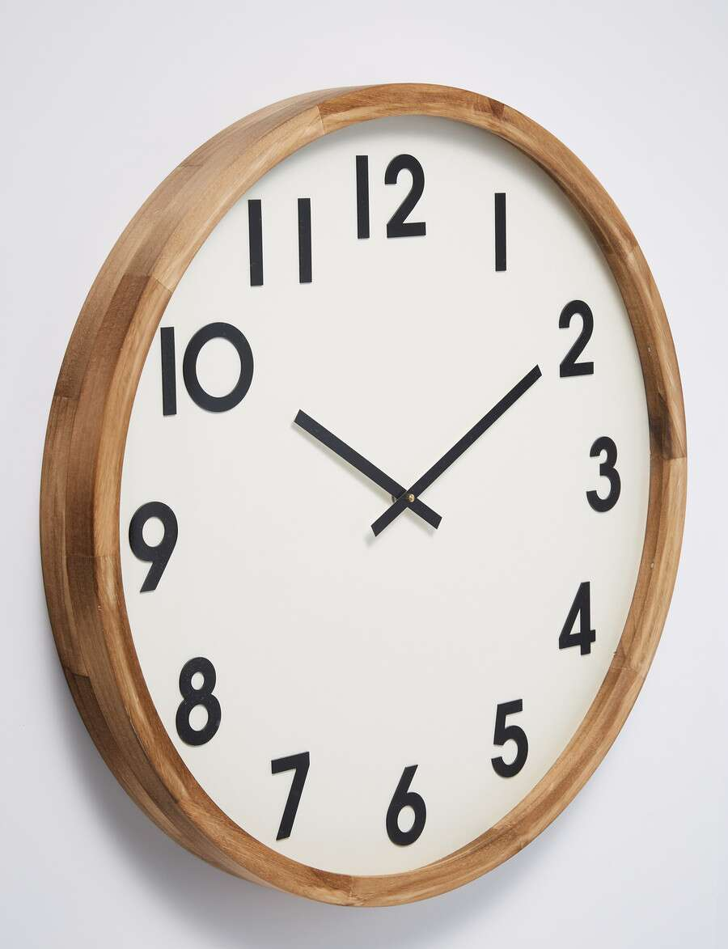
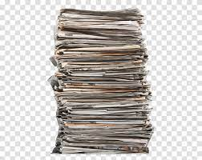
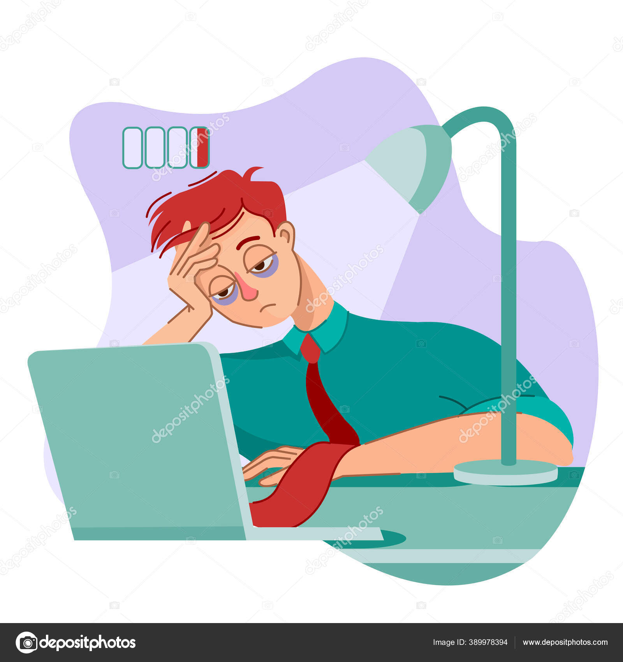
Problems:
Daily multitasking:
The time available does not match the required tasks:
Lots of information sources:
Exerting more mental and physical effort:

Slide 4
Objectives :
Try to reduce the size of the tasks :
Save some time for the user:
Helping the user to find as many sources as possible in the shortest possible time:
Reduce user effort:

Slide 5
Solutions :
The ability to summarize texts with high accuracy:
There is more than one way to enter text
( upload a text file ):
Enable the text-to-speech feature in the program:

Slide 6
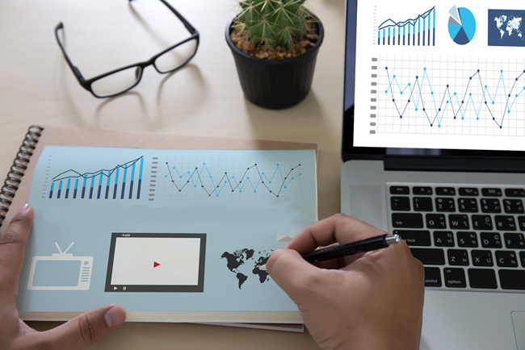
Introduction and related work

Slide 7
Introduction
( Summarizeit) will be one of the best free apps
for summarizing the long documents in an easy way with the DL
after the user inter the text , It will be processed to be ready
for processing with the pre trained model , then the result will be matched
With predicted words ,the send it to the app to display it to the user

Slide 8
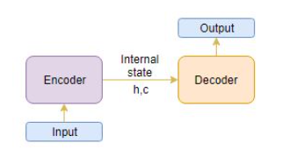
related work
Seq2Seq => Encoder Decoder
- (Seq2Seq) are the approach that we needed to implement to solve the problem of many to many

Slide 9
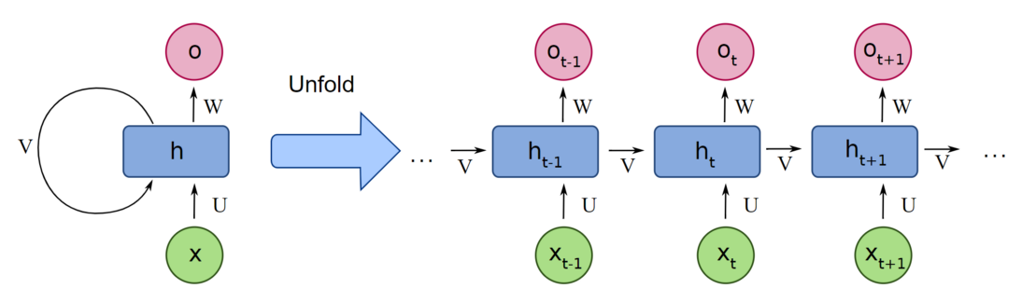
related work
recurrent neural network (RNN)
- (RNN) are the state of the art algorithm for sequential data

Slide 10
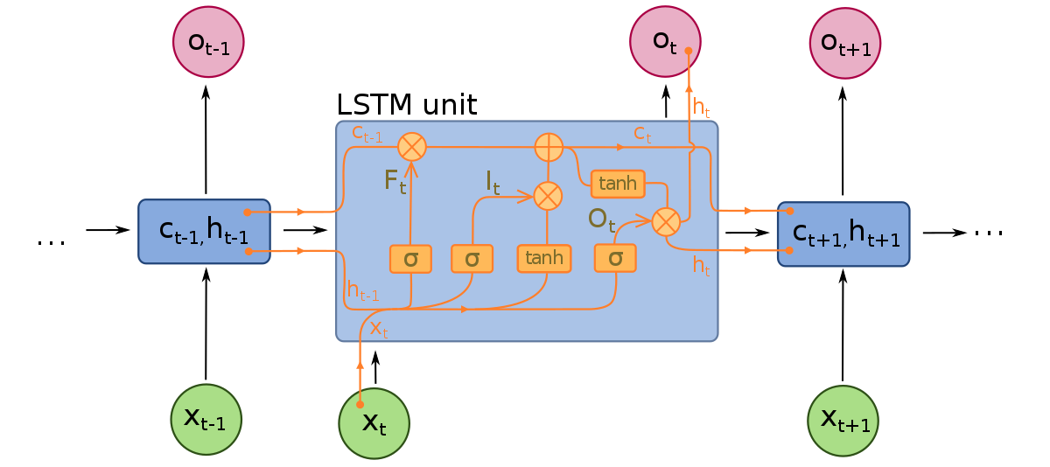
related work
Long Short Term Memory(LSTM)
- (LSTM) is one of the RNN algorithm’s that allows information to persevere
and can handle the vanishing gradient problem

Slide 11
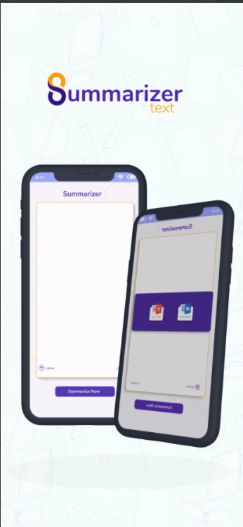
related work
SummarizerText
SummarizerText is an ios app that helps you to summarize the wiki articles ,
Disadvantages
- The app is no accurate , predicts wrong summary

Slide 12
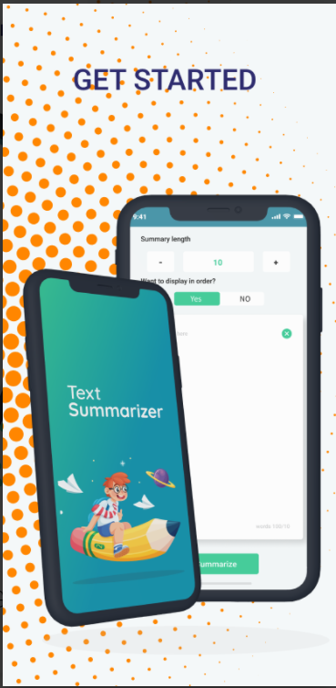
related work
Text Summarizer_AI
Text Summarizer is an ios app that helps you to summarize the educational books ,
Disadvantages
The app is no accurate , predicts repeated words
Need not pay for it to use many times

Slide 13
Design and
Diagrams

Slide 14
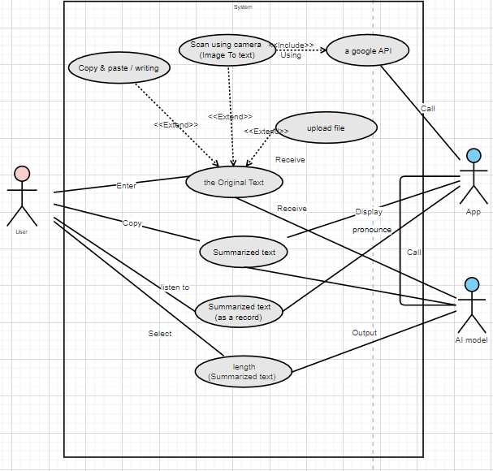
UseCase Diagram

Slide 15
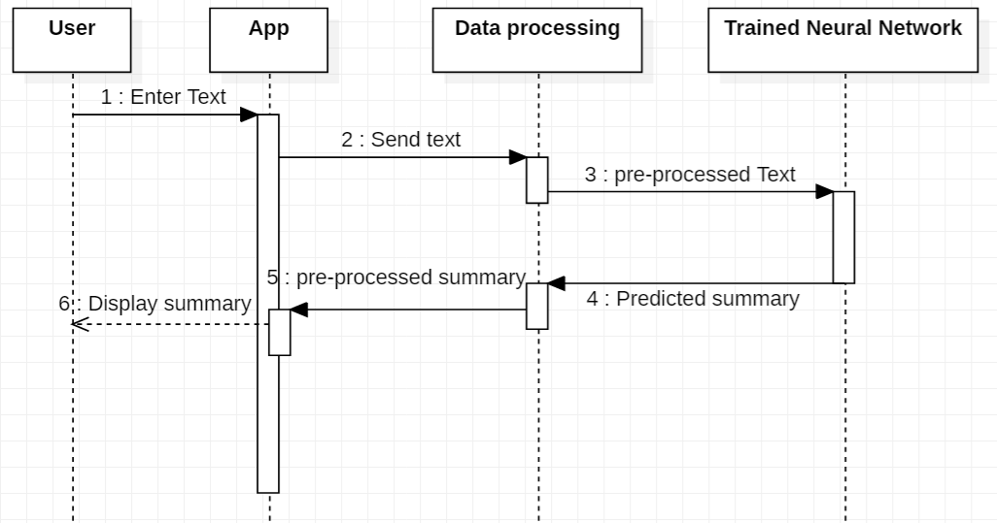
Sequence Diagram

Slide 16
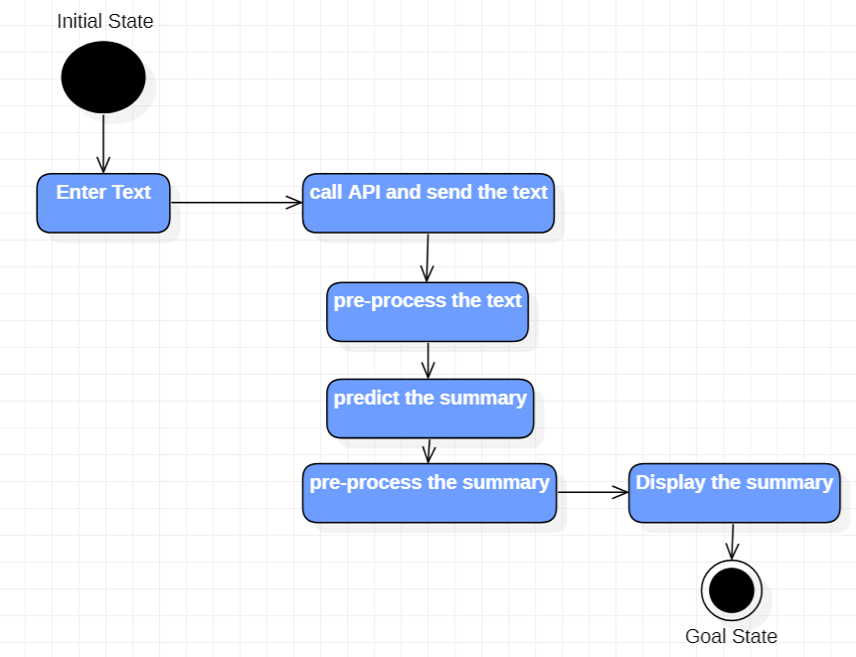
State Diagram

Slide 17
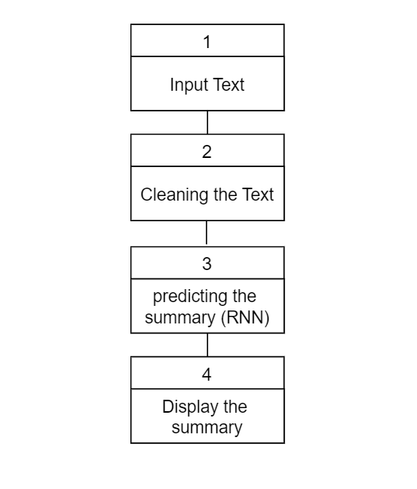
Block Diagram

Slide 18
Proposed model and implementation

Slide 19
Machine Learning Model
I looked for a suitable dataset for the project and decided to use (Amazon Fine Foods Reviews).
I compared the different algorithms and decided to use RNN, seq2seq model, Because it is better at dealing with Text data ,
Learning resources: Machine learning from a to z Deep learning from a to z Google Colab crash course Study the existing models from Kaggle

Slide 20
Machine Learning Model - Problems
Accuracy 60%
Solved by studying the existing models then make my unique technique (RNN Layers) after that Accuracy improved to 81.80%.
The accuracy not enough to test our model
Solved by implementing the ROUG test , and the Result is
rouge-1 = 0.60 , rouge-2 = 0.40 , rouge-l = 0.64
How to save the wights of model in a file? to load it to the model when needed
Solved by studying some old codes from stack overflow
Google Colab very slow
Solved by purchase a Google Colab Pro.

Slide 21
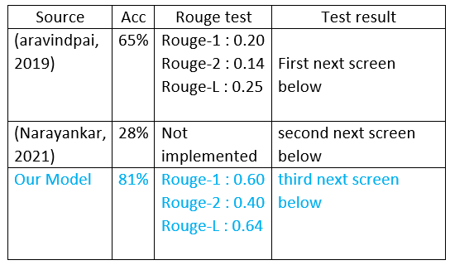
Comparing results with model with the same dataset

Slide 22
Flutter App
Learning resources:
Flutter Complete Guide (Udemy)
The application was designed to be a tow screens and connected to the AI model with a REST API
I used Flask back-end technology to set up the REST API

Slide 23
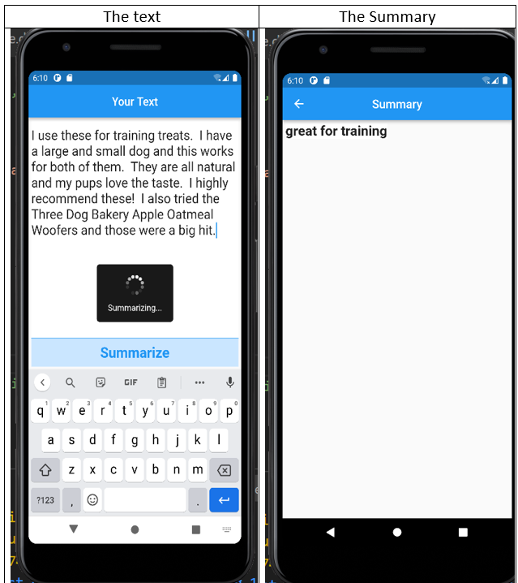
Result of the Flutter app

Slide 24
Future work

Slide 25
Future Work
Add some features, such as
I will train the model on a larger dataset .
The possibility of creating an account (although it is not required to do a quick check).
I will implement the BILSTM algorithm (which I already working on currently ) .
Train the model on a deferent datasets to be a general summarizer app
Implementing the feature of scanning text from images
Implementing the feature of text to speech
Making a free version and a paid version for companies with more features that are specially developed according to the needs of each institution.

Slide 26
Thanks!
Any questions?
You can find me at:
awad.safwat1999@gmail.com
01112375546

